Slide 1
https://threatmap.bitdefender.com/

Slide 2



PAGE 1
cyber security
www.olsontyler.com

Slide 3

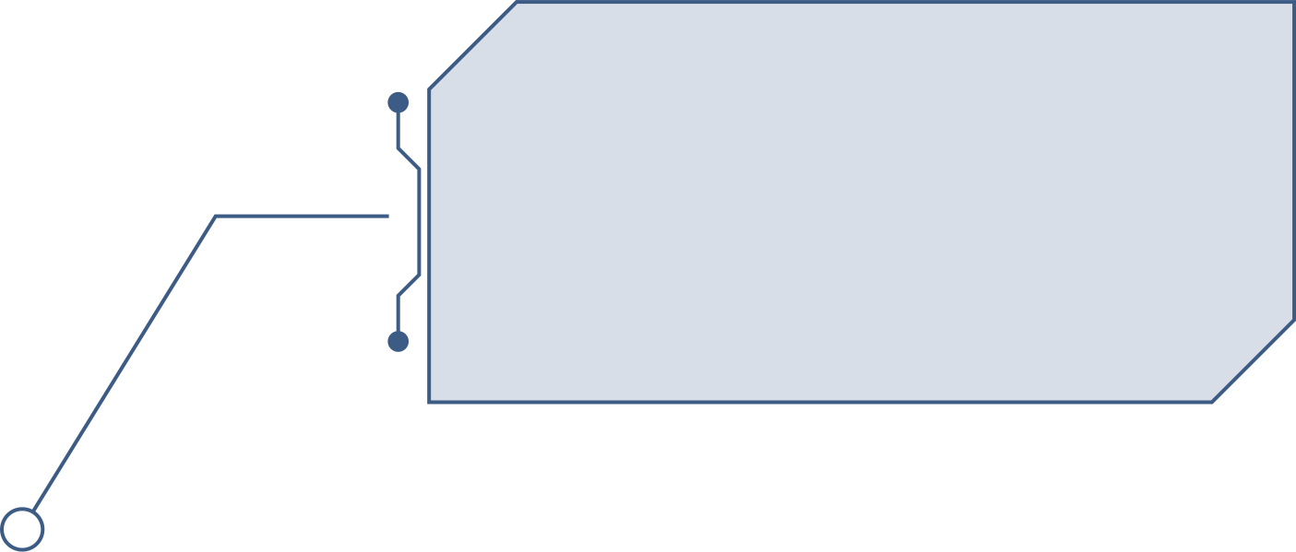


PAGE 2
Written Section
50 - 70 Multiple choice test, similar to Security+ and other security Exams.
Competition Sections
Capture The Flag
The top 10% from the test move on to a CTF starting as soon as the last person is done

Slide 4
PAGE 3
Topics Covered
Major News
Crpytography
Regulations
The Written exam will ask questions like in X attack what was the group involved in facilitating the attack? I imagine this year we will see items about crowdstrike, supply chain, and some AI.
Nationals had several cryptogrophy questions. We will go over some basics soon to make sure we are on the same page
Theres a couple questions in there pretaining to cyber security regulations more pretining to time to report.

Slide 5
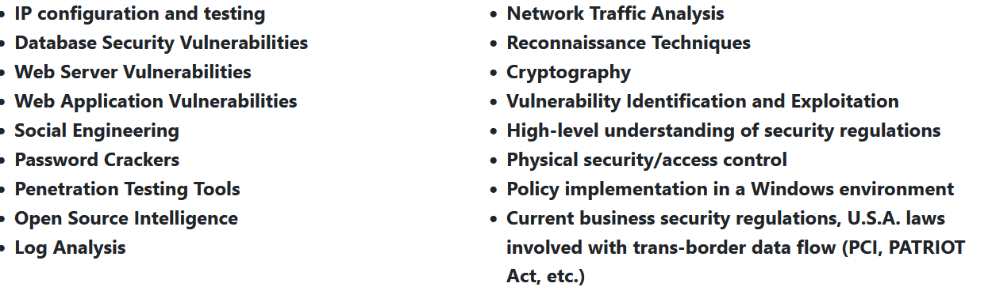
#

Slide 6
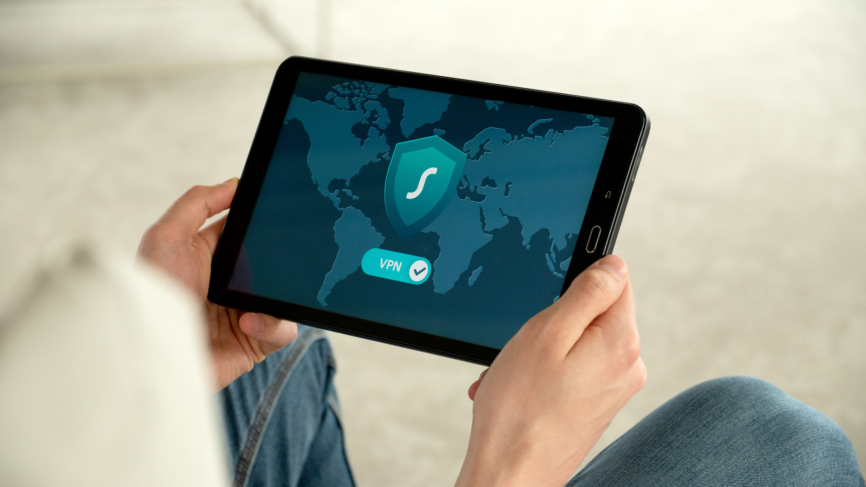
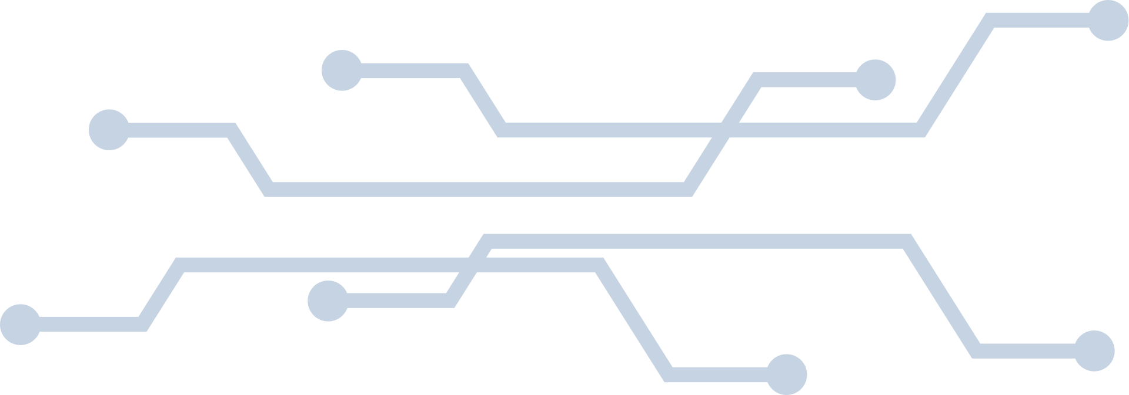
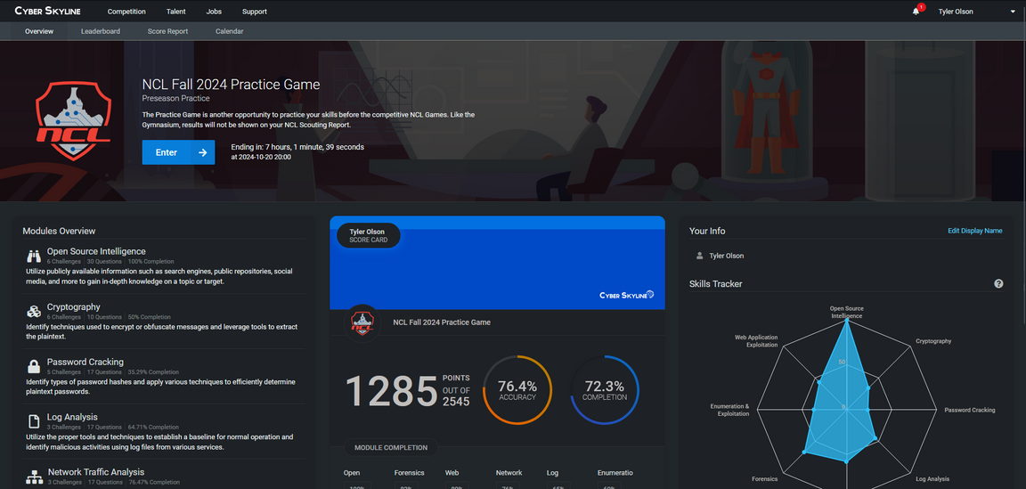
PAGE 5
Capture the Flag
If called back you will compete in a CTF involving a lot of log analysis ( look at this log and find x file or x ip address). Your making a massive incident report.
Lets take a look at a similar CTF:

Slide 7
PAGE 6
Resources
Hack The Box / Try Hack Me
News Sites
MITRE Vectors
Hack the box provides great resources to complete some “boxes” in order to practice what CTF challenges will look like
I use an RSS feed on my phone to get the latest in news from several different cybersecurity websites. I highly recomend taking some time to look at the large news articles and other events in cyber!
Want to know how malware works? check out Mitre ATT&CK to find out more about vulnerabilities
https://attack.mitre.org/

Slide 8
PAGE 7
Networking

Slide 9

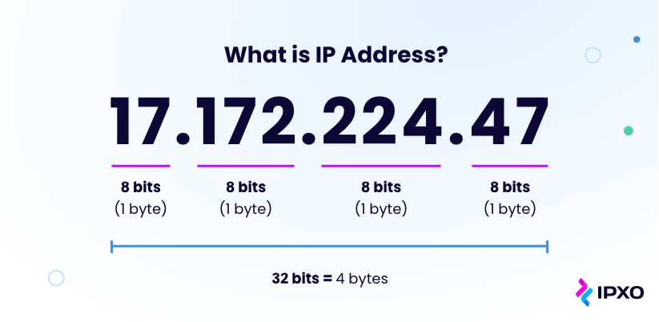
PAGE 8
IP Addressing

Slide 10
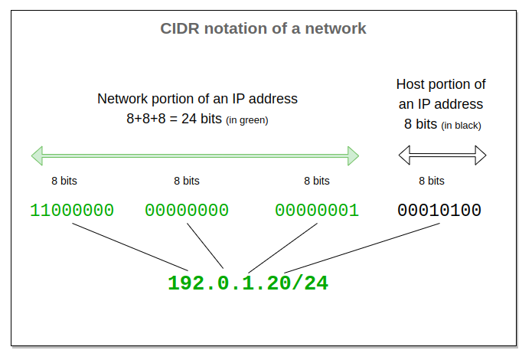
Cidr Notation
PAGE 9
CIDR Notation is the fast way to write your network mask (Like 255.255.255.0 that defines what ip addresses you computer can get

Slide 11
PAGE 10
Web Security

Slide 12
PAGE 11
Common Vulnerabilities
Broken Access Control
Cryptographic Failures
Injection
Users can act outside of their intended permissions from viewing folders they shouldn’t be able to. to finding files not intended for public display
Google
“not for public release filtype:pdf”
Lack of encryption, passwords or data stored in plaintext. card data not encrypted etc.
The good old classic sql injection
running a
“ or “”=” in the password field if not properly santized to log right in to an account
https://owasp.org/www-project-top-ten/

Slide 13
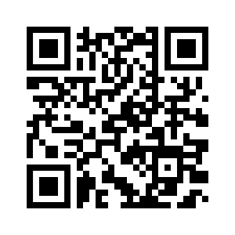
PAGE 12
Juice Shop
https://owasp.org/www-project-juice-shop/

Slide 14
PAGE 13
Cryptography

Slide 15
PAGE 14
The Basics
“Cryptography is the process of hiding or coding information so that only the person a message was intended for can read it. The art of cryptography has been used to code messages for thousands of years and continues to be used in bank cards, computer passwords, and ecommerce.” -Fortinet
  Traces its roots back to Julius Caesar (Caesar Cipher)
  1970s IBM developed Data Encryption Standard (DES) Algorithm
  1977 RSA Algoritm was published
Symmetric Key
A-Symmetric Key
One key to encrypt / decrypt
Public / Private Key pairs

Slide 16
PAGE 15
Algoritms
Rivest - Shadmir - Aldeman (RSA)
Data Encryption Standard (DES)
Advanced Encryption Standard
Public-Key System Developed for Intelligence encryption
Uses two large prime numbers
Factoring two prime numbers is near impossible
First main computer encryption standard Replaced by triple DES With three keys of 56 bytes
Phased out and has been broken many times
This is the current government standard using keys of 192 and 256 bits

Slide 17
PAGE 16
Quantum Computers
Each year the amount of bits of a key that quantum can hack grows, the latest one was 22-bit keys. This has put NIST in a rush to get new standards for encryption out and ready to go for when not if quantum computers are able to crack our encryption.

Slide 18
PAGE 17
Regulations

Slide 19
PAGE 18
Types of controls
Managerial
Operational
Technical
Controls implemented at the Managerial level for Information Technology Management
Controls around the operations of an organziation, like how data is secured.
Implemented on the technical end, IE MFA, Pass word policies and others

Slide 20
PAGE 18
Control Types
Preventive
Detective
Corrective
Attempting to PREVENT cyber attack
Firewalls
Attempting to DETECT attacks
Log Analysis
Attempting to CORRECT damage
Data backups
Deterrent
Compensating
Physical
DETER attacks before they start
Legal punishments
Compensate for other controls
Red Teaming
Secure the property from attack

Slide 21
PAGE 18
Regulations
PCI
PATRIOT ACT
GDPR
Payment Card Industry standards. If you are accepting payments I better hope you are following PCI. Provides core protection through encryption and secure software
https://www.pcisecuritystandards.org/
War on terror act. Affecting information disclosures by organizations in national security incidents. Requring disclosure from ISP’s
Signed by George W Bush in October 26 2001
You seen those cookie pop ups? Thank GDPR
Applies to people in the European Union protecting their data from being stored outside of the EU. Millions of dollars of fines come every month out of this regulation
https://gdpr-info.eu/

Slide 22
PAGE 19
Recent Events

Slide 23
PAGE 20
CrowdStrike
Largest IT Outage in HISTORY. $5 billion dollars worth of direct losses according to one insurer July 2024.
8 million computers blue screened constantly due to an error in the root driver caused by a channel file being added with 12 parameters instead of 13.
https://www.crowdstrike.com/wp-content/uploads/2024/08/Channel-File-291-Incident-Root-Cause-Analysis-08.06.2024.pdf

Slide 24
PAGE 21
Russian Attacks
Advent of the Russia / Ukraine war has seen a massive increase in cyber attacks and shown us how cyber attacks have become weapons of war
February 2022 Many russian officers in unit 29155 were indicted for large-scale cyber attacks against ukraine.
September 4th the U.S Filed charges against employees of the Russian media group network RT in an effort to hire a company to influence the 2024 election using shell companies and personas
Blackouts in ukraine caused by malware “Industroyer One and Two”

Slide 25
PAGE 22
Pollyfill.io
Attacked the pollyfill library used by websites researchers at sensec discovered java script code injected into 110,000 websites including phishing and advertising on June 25th (They even got ddosed on the 26th)
Code was based on http headers, one redirected mobile users to a sports betting site using the domain ww.googie-anaiytics.com only activating at specific hours or against admin users or web analytics.
https://sansec.io/research/polyfill-supply-chain-attack
if she works:
http://web.archive.org/web/20240000000000*/pollyfill.io
https://www.csis.org/programs/strategic-technologies-program/significant-cyber-incidents

Slide 26
PAGE 10
Questions?

